Slide 1
Make Your CV Stand Out
Evelina Sredovska
Employment & Skills Lead

Slide 3
Economic Inclusion
Employment support
Skills & Training
Direct jobs and apprenticeships with different employers
Start-up and business support
Childcare careers

Slide 4
The Basics
CV = Curriculum Vitae = the story of your life (not personal!)
2 pages long
Avoid personal details and pictures
Avoid details relating to your protected characteristics like your age or DOB, nationality etc.
Make sure your email is professional
Think whether you need to include your address

Slide 5
The important stuff
Your CV is a marketing document. It advertises you!
ATS – applicant tracking systems
CV file format
CV structure
Words you use!
What is the employer really looking for? Who is their ideal candidate? And how do you ‘match’ this profile?

Slide 6
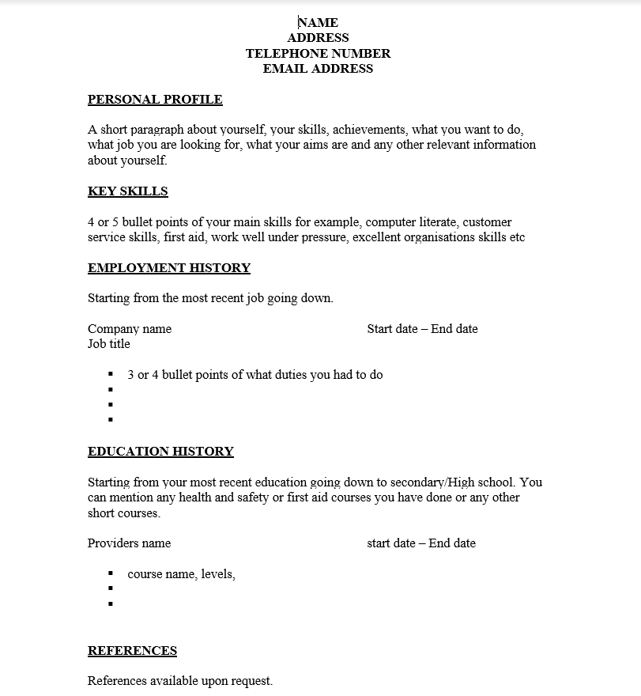

Slide 7
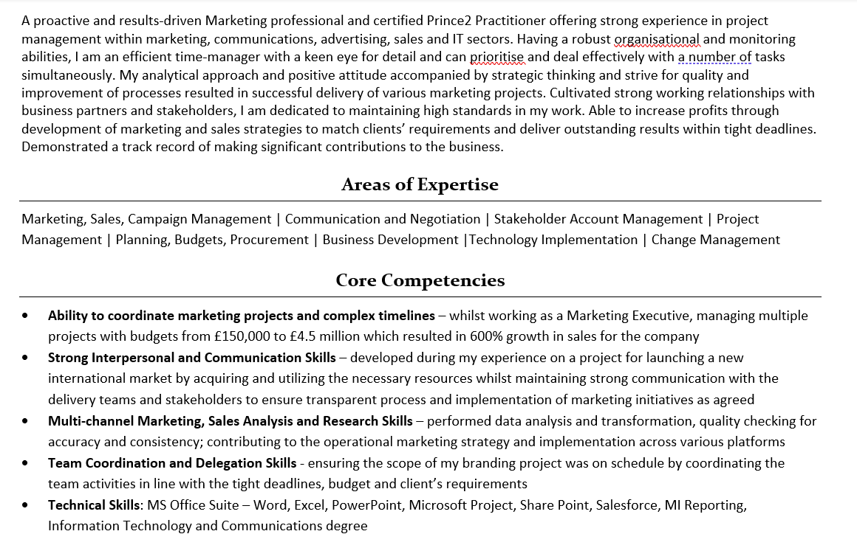
Let’s upgrade the CV!

Slide 8
The thing that no one wants you to know

Slide 9
Email: employment.training@peabody.org.uk
Question time

